Slide 1
S-100 Validation Tests sub group
9th VTC Meeting
12th September 2024

Slide 2
Meeting protocol
Meeting participants are kindly requested to note the following meeting protocols;
Please keep your camera and microphone turned “off” if you are not talking or presenting
If you want to make an intervention, please turn your camera and microphone on and, raise your hand to indicate that you wish to speak
Don’t forget to turn your microphone “on” before speaking, and “off” when finished
Please use the “Chat” function to communicate an text information to the meeting
If you have any problems connecting using Firefox or other browser – please try using Chrome.

Slide 3
AGENDA
HSSC - Summary of meeting relevant to S-100 Validation
Review of draft S-158:100, S-158:101
S-100 Validation template
Issues identified while preparing S-158 draft
Preparation for S-100 WG9 meeting in November
Status on tasks
Next meeting

Slide 4
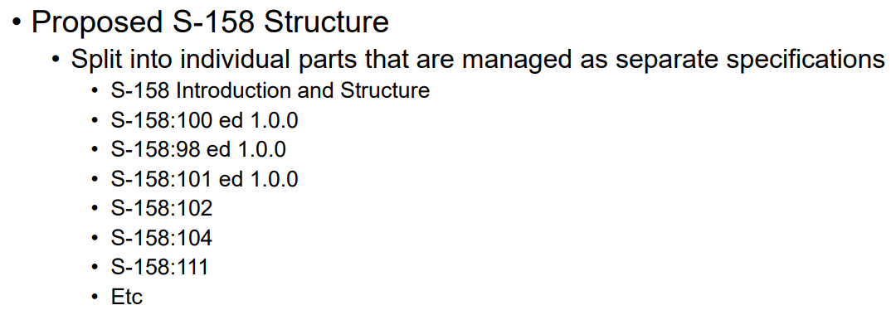
Hssc summary – items relevant to S-100 validation
Approved the use of S-158 & agreed structure
Validation checks against S-100 itself
S-98 Validation (including cross product)
Parts for Validation checks for individual S-100
Product Specifications
These will be managed by individual HSSC WGs/PTs (development, submission, endorsement and approval)
High risk of not meeting the deadline
Will be submitted to HSSC 17 2025 (aiming for a December deadline)
S-100 Validation has joined the ISO Cell group to track progress as there are concerns regarding completion.

Slide 5
draft S-158:100, S-158:101
Contract issued for Raphael to draft the S-158 document
Overall document (cover document) – S-158 Validation Checks – Introduction and Structure
https://github.com/iho-ohi/S-100-Validation-Checks/blob/main/Documents/S-158%20Validation_Checks_0_1_0_20240823.docx
S-158:100 Universal Hydrographic Data Model Validation Checks (document)
https://github.com/iho-ohi/S-100-Validation-Checks/blob/main/Documents/S-158_100%20Universal%20Hydrographic%20Model%20Validation_Checks_0_1_0_20240823.docx
S-100 Validation Checks
https://github.com/iho-ohi/S-100-Validation-Checks/blob/main/Documents/S-158%20Validation_Checks_0_1_0_20240823.docx

Slide 6
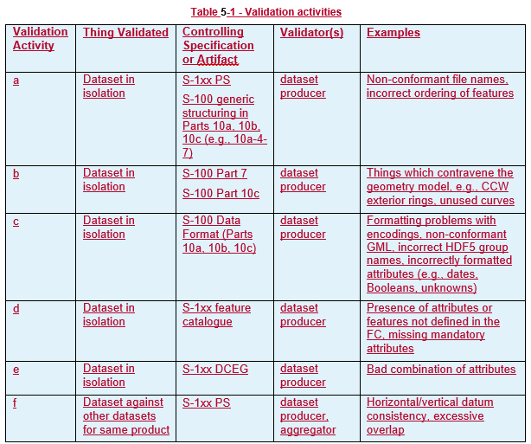
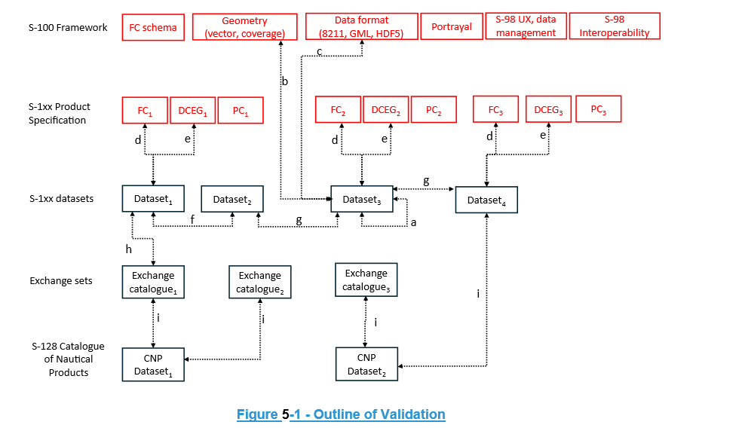
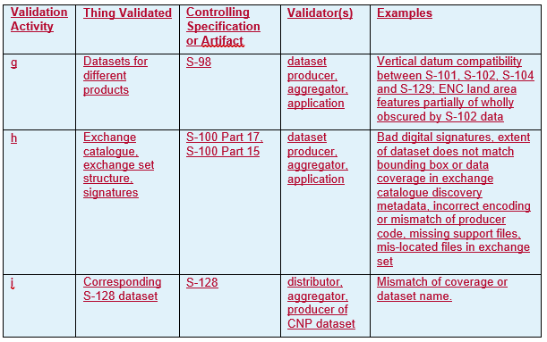
Validation diagram

Slide 7
S-100 Validation template
Purpose is to simplify maintenance of the checks and to help data producers & validation tool manufacturers by having more consistency in how the errors report.
Distributed to PS owners in July
Naming convention guidelines:
The naming convention is Sxxx_0001 and then increases numerically e.g. S101_0001 and then S101_0002
All PS checks must have four digits
No letters can be used in the validation checks (can discuss if need to change)
If a PS wishes to group validation checks into themes, and potentially allocate numbering ranges that is their choice and they must provide wording explaining the structure/groupings of the checks
Once a validation check number has been used, it cannot be reused, even if the check has been cancelled, unless it is to reintroduce the previously cancelled check
It is recognized that each PS may have unique requirements, so it is possible for each PS to add their own checks AFTER the standardized list of columns. I appreciate this may sometimes make the checks less streamlined to read and that is why we would like feedback and input on how to improve this.
Feedback due by September 20th to allow time to report back to S-100 WG
DQWG & S-101 have sent comments so far
S-101 have supplied their validation checks, so Raphael has formatted them in the template structure & draft cover document which are with S-101 Validation for comment.
https://github.com/iho-ohi/S-100-Validation-Checks/tree/main/Product%20Specification%20Validation%20Tests

Slide 8
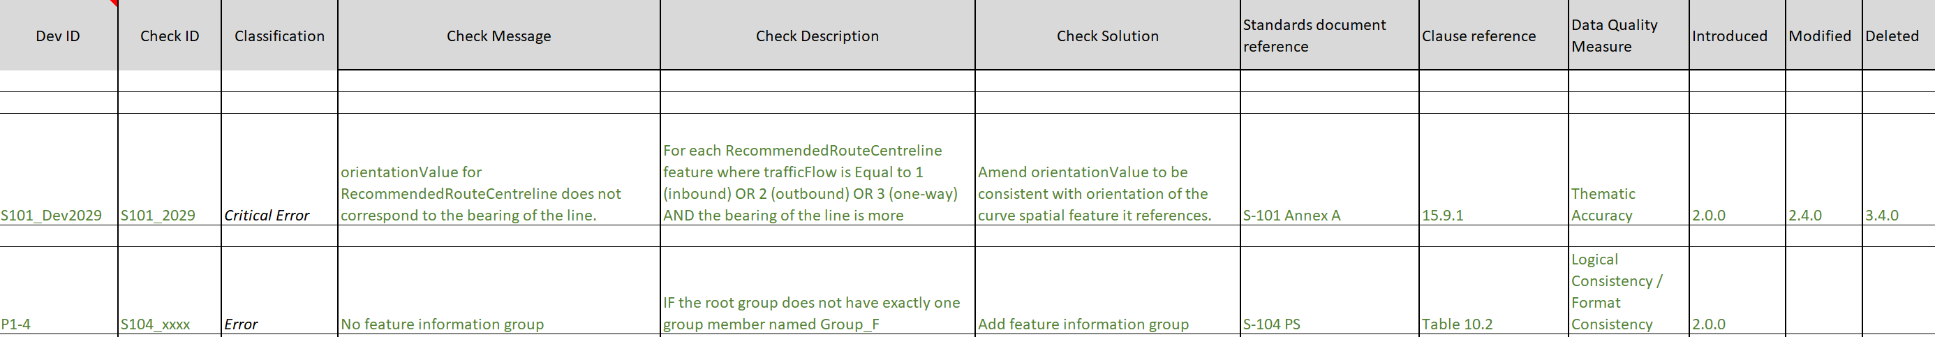
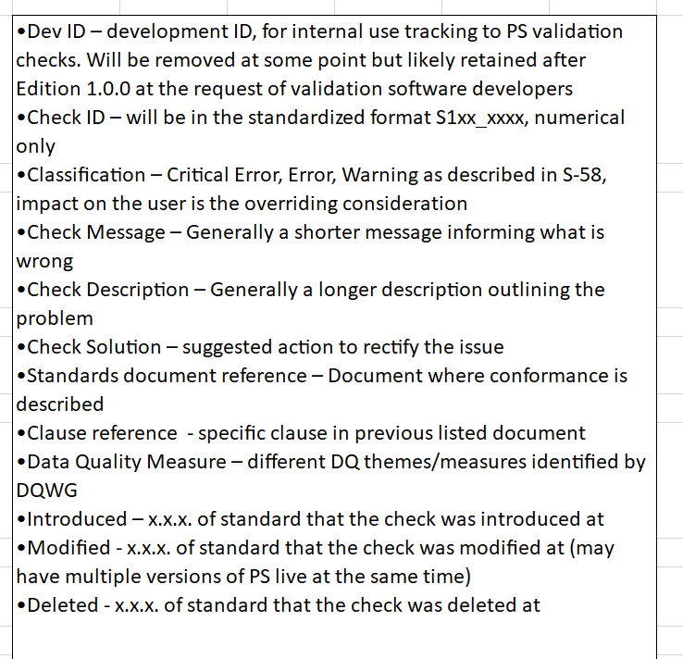
Comments so far:
Wish to keep the Dev ID for first publication
Whether a column to capture checks that have been superseded is needed, for S-101 this would allow the relationships to S-58 to be captured. Maybe we retain this in the WG version only and for developmental purposes? Perhaps covered by the change log
S-101 has a special case as need an additional column relating to S-58.
Perhaps a common structure for a change log for these checks would also be useful?
DQWG – recommend switching DQ Measure and Classification
Recommend follow ordering in data quality evaluation – need to review, very different

Slide 9
Issues identified while preparing S-158 draft
How to manage machine readable vs human readable
How to manage citations/ clause references
Versioning – review and escalate to S-100 WG
What constitutes a clarification and a revision?
first two numbers need to be synchronous, will this work?
Some S-101 supplied S-100 checks need reviewing, not complete or clear. Forwarded to S-101 for review
Some Part 4a checks are now Part 17, need new clause and check for duplicates
DQ Measures – do we want them?
How we ‘publish’ the documents – will Metanorma work?
Do we need to reference S-100 checks to PSs?
Have not received validation checks from most PSs, possibly not until later in the year.
Impacts of S-98 ‘interoperability’ changes
Structure of GitHub documents repository

Slide 10
Preparation for S-100 WG9 meeting in November
How indicate what S-1xx checks relate to what?
Versioning
Question the use of Part 6, is anyone using it? If not, delete/ archive 11 validation checks written so far
Use of current S-58 Classifications – Warning, Error and Critical – very ENC and ECDIS specific. Have used so far. Julia recommended a paper for S-100 WG.
Submission related to Part 7 Issue #22 Inconsistency in S-100
Part 7 check S100_Dev0088 · Issue #22 · iho-ohi/S-100-Validation-Checks (github.com)
Feedback from template from PSs
Change log & Managed Impact Study timeline

Slide 11
Status on tasks
Current Situation
Template and Standardised Naming Convention out on circulation
S-100 checks are in the new format and the duplicate numbering issue has been resolved
https://github.com/iho-ohi/S-100-Validation-Checks/blob/main/Documents/S-158_100_0_1_0_20240823.xlsx
Updated to S-100 5.2.0
No further progress in writing new checks since S-100 WG8, looking into funding options. Primar are drafting Part 15 checks
Cross product validation checks, looking into funding options
Will be submitted to HSSC 17 2025
Update to S-97 outstanding – broader S-100 WG task
Initial tests Part1, Part 2, Part 4b, Part 5, Part 6, Part 7(not finished), Part 10a (not finished), Part 10c, Part 17, Draft Part 15 (PRIMAR)

Slide 12
ISSues
https://github.com/iho-ohi/S-100-Validation-Checks/issues

Slide 13
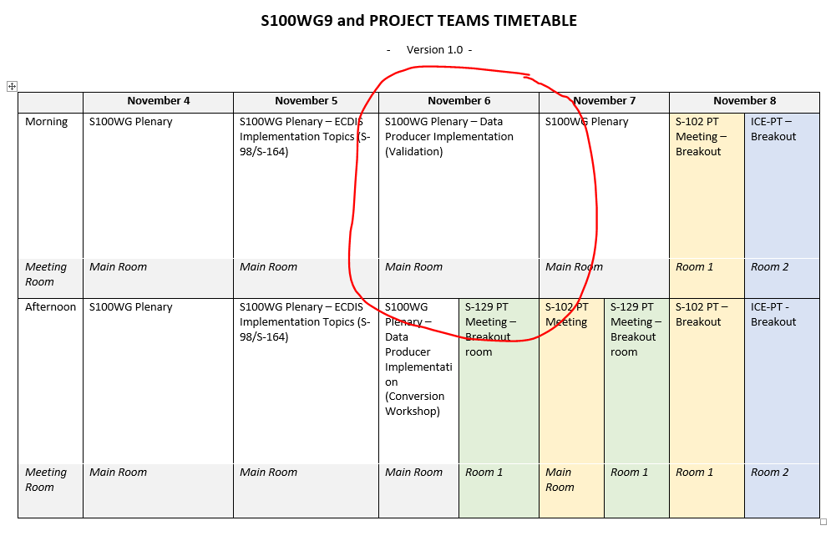
Next steps
Continue producing a set of tests from Parts of S-100, looking into funding options
Review feedback from naming convention and validation test structure
Coordinate Cross-Product Validation with S-98/S-164 lead, DQWG and S-1xx PS owners
Adopt S-1xx validation tests into S-158:1xx when received
Review draft documents and validation checks by 15th October ready for next meeting and S-100 WG
Prepare papers and validation session for S-100 WG9

Slide 14
Next meetings
S-100WG9, Genoa, Italy – 04/11/24 – 08/11/24
Suggest next meeting is Monday 28th October.
Any volunteers to write or review checks please contact me and Yong.

Slide 15
Any Questions?

